Slide 1
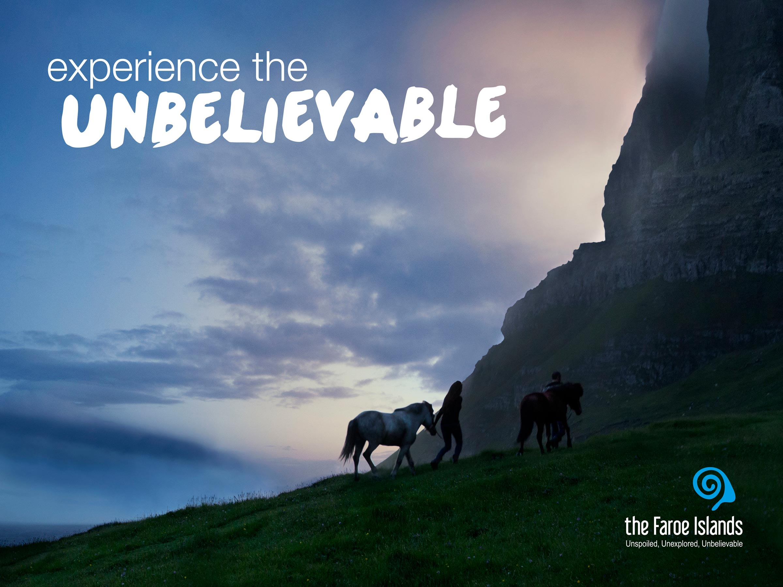
Notes:
When we take a look at all the descriptions of the Faroe Islands that tourists have made, there is a clear pattern. Unspoiled, unexploited, unpolluted, unexplored... Many of the words used to describe the Faroe Islands are so-called un-words. Perhaps ordinary descriptive words just aren't adequate. Or perhaps this hidden, treeless land of contrasts, evokes such unique emotions in its visitors, that the best way to describe it is by setting it apart from the rest, by applying the inherent meaning of the small, yet powerful prefix, un.
The Faroe Islands are unbelievable. The nature is a combination of hard rocks, green grass and dramatic waterfalls. A stunning picture painted in green and blue colors, where your eyes can stretch from the top of a mountain over the endless surrounding ocean at any one time. The strong culture is a result of it islands isolation and remoteness from the rest of the world. The ocean has served as a great defense against dilution of the islands’ original culture. And as many destinations seem to be getting more alike, the contrast to the Faroe Islands becomes even greater. The Faroe Islands have a unique feeling of “real”. Nature is the only true ruler and the humbling effect of nature is evident in the island’s culture. The Faroe Islands may be close in distance but are far, far from everyday life. Far from stressful obligations. Far from traffic jams and crowds. Far from normality and everyday routines. People are welcoming and open and nature invites everyone to participate. The nature is not just something you look at. It’s a place for being – for hiking, painting, angling, diving, sailing and absorbing.
Gævi gætur at Visit Faroe Islands eigur rættindi til allar myndirnar í framløgunum og at myndirnar bert kunnu brúkast í hesum líki í samband við framløgur um Føroyar.

Slide 2
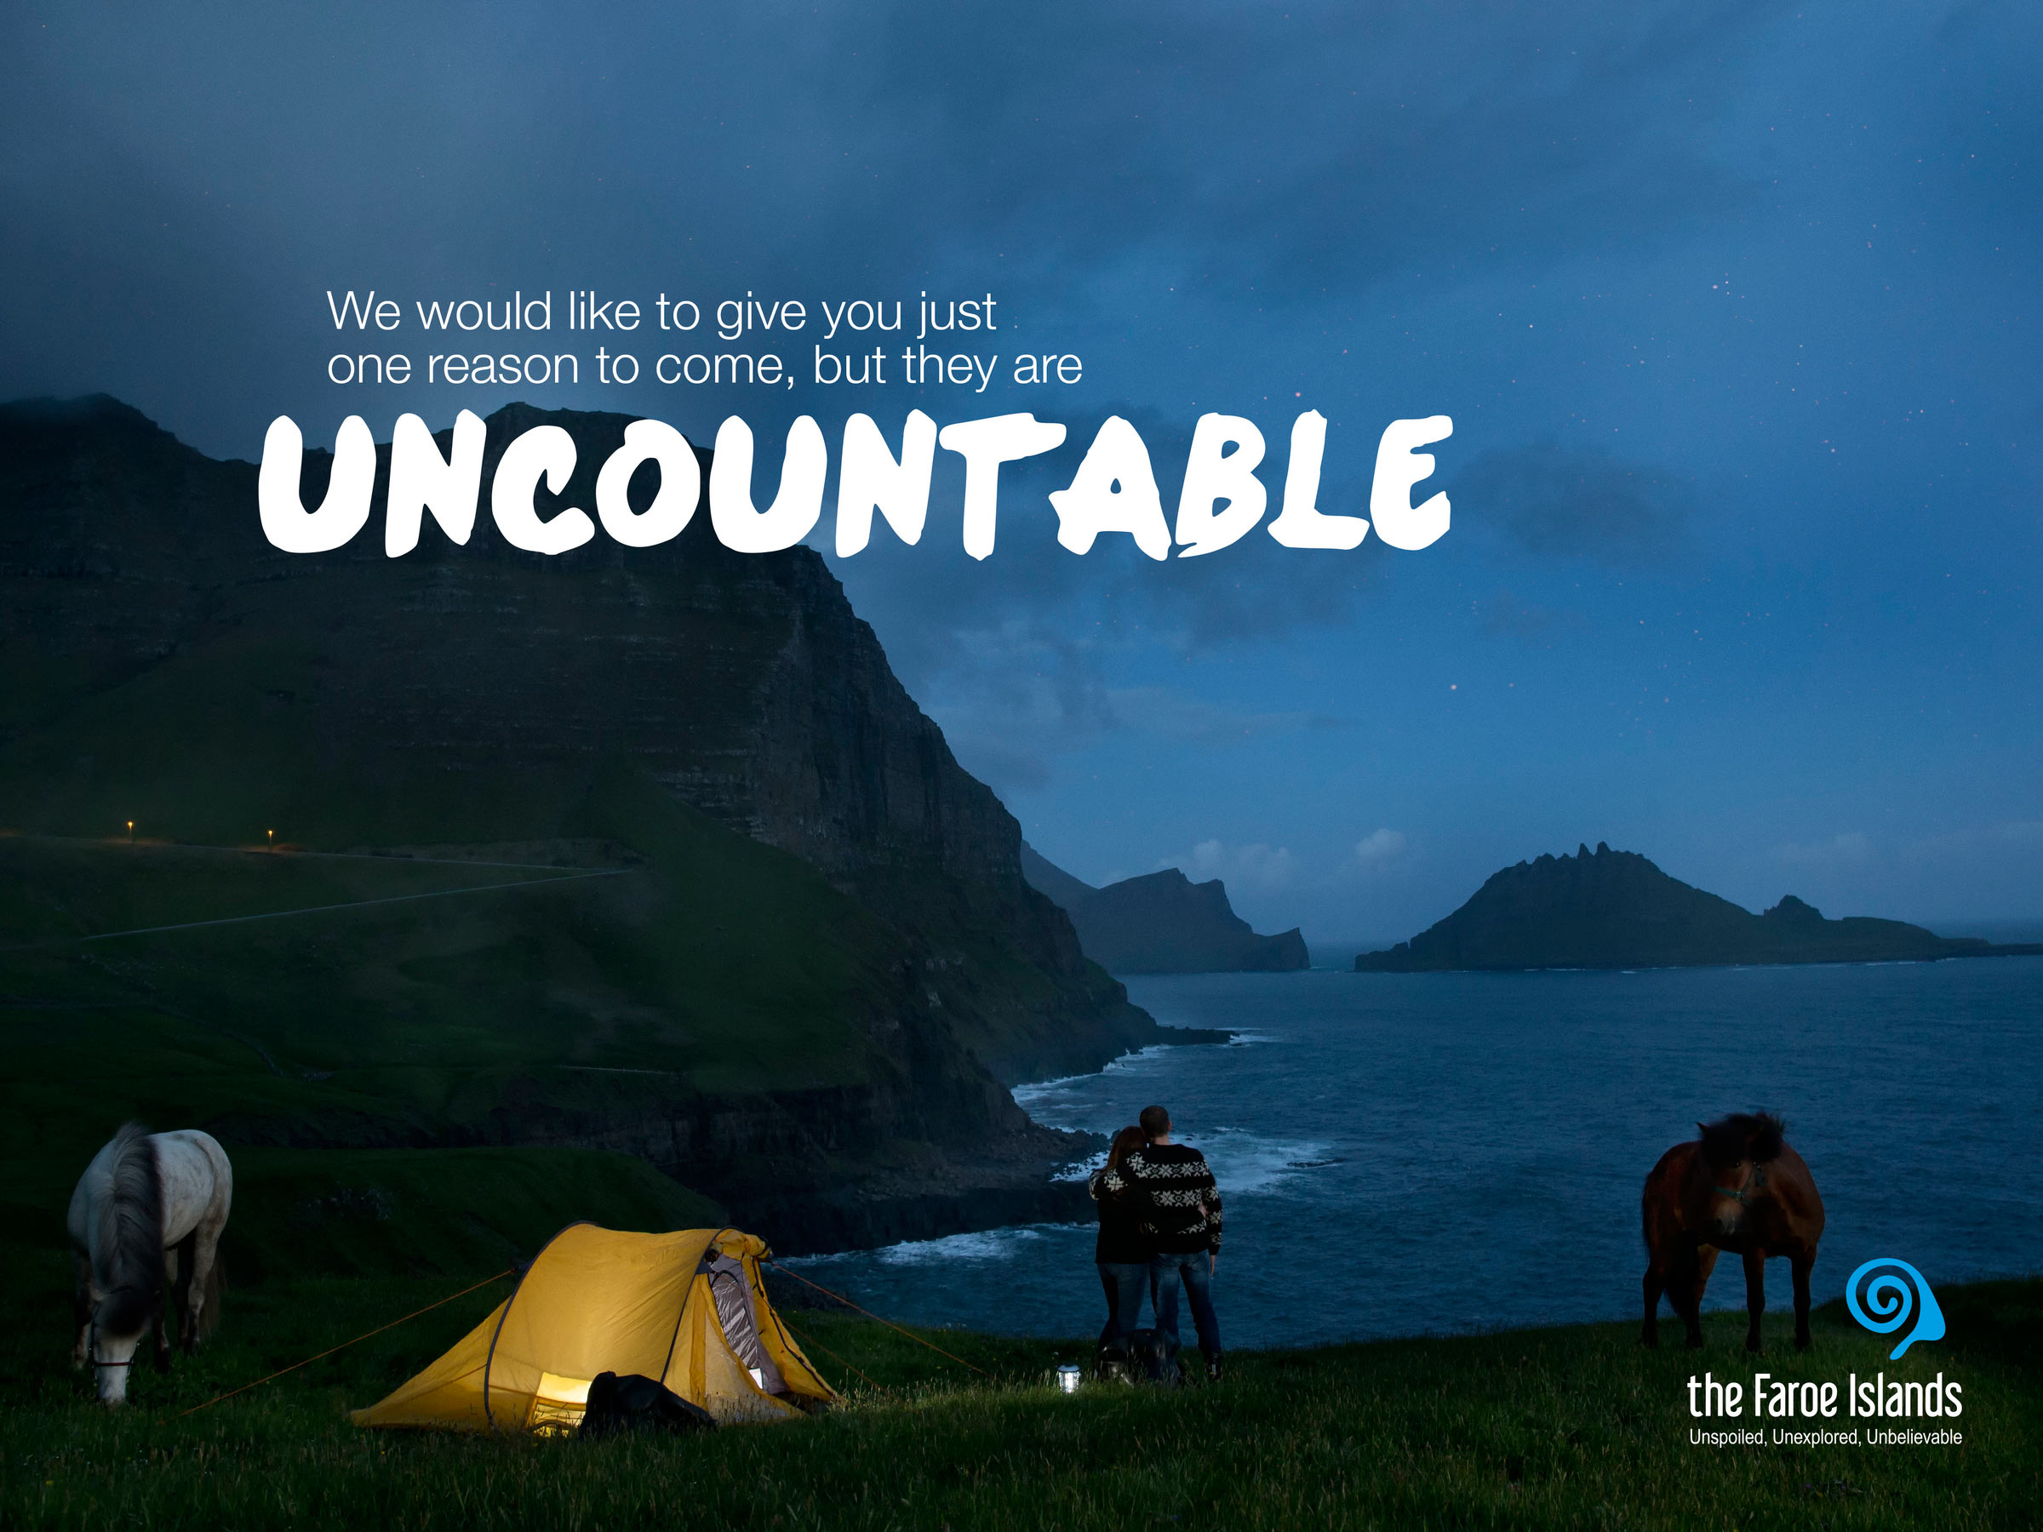
Notes:
Gævi gætur at Visit Faroe Islands eigur rættindi til allar myndirnar í framløgunum og at myndirnar bert kunnu brúkast í hesum líki í samband við framløgur um Føroyar.

Slide 3
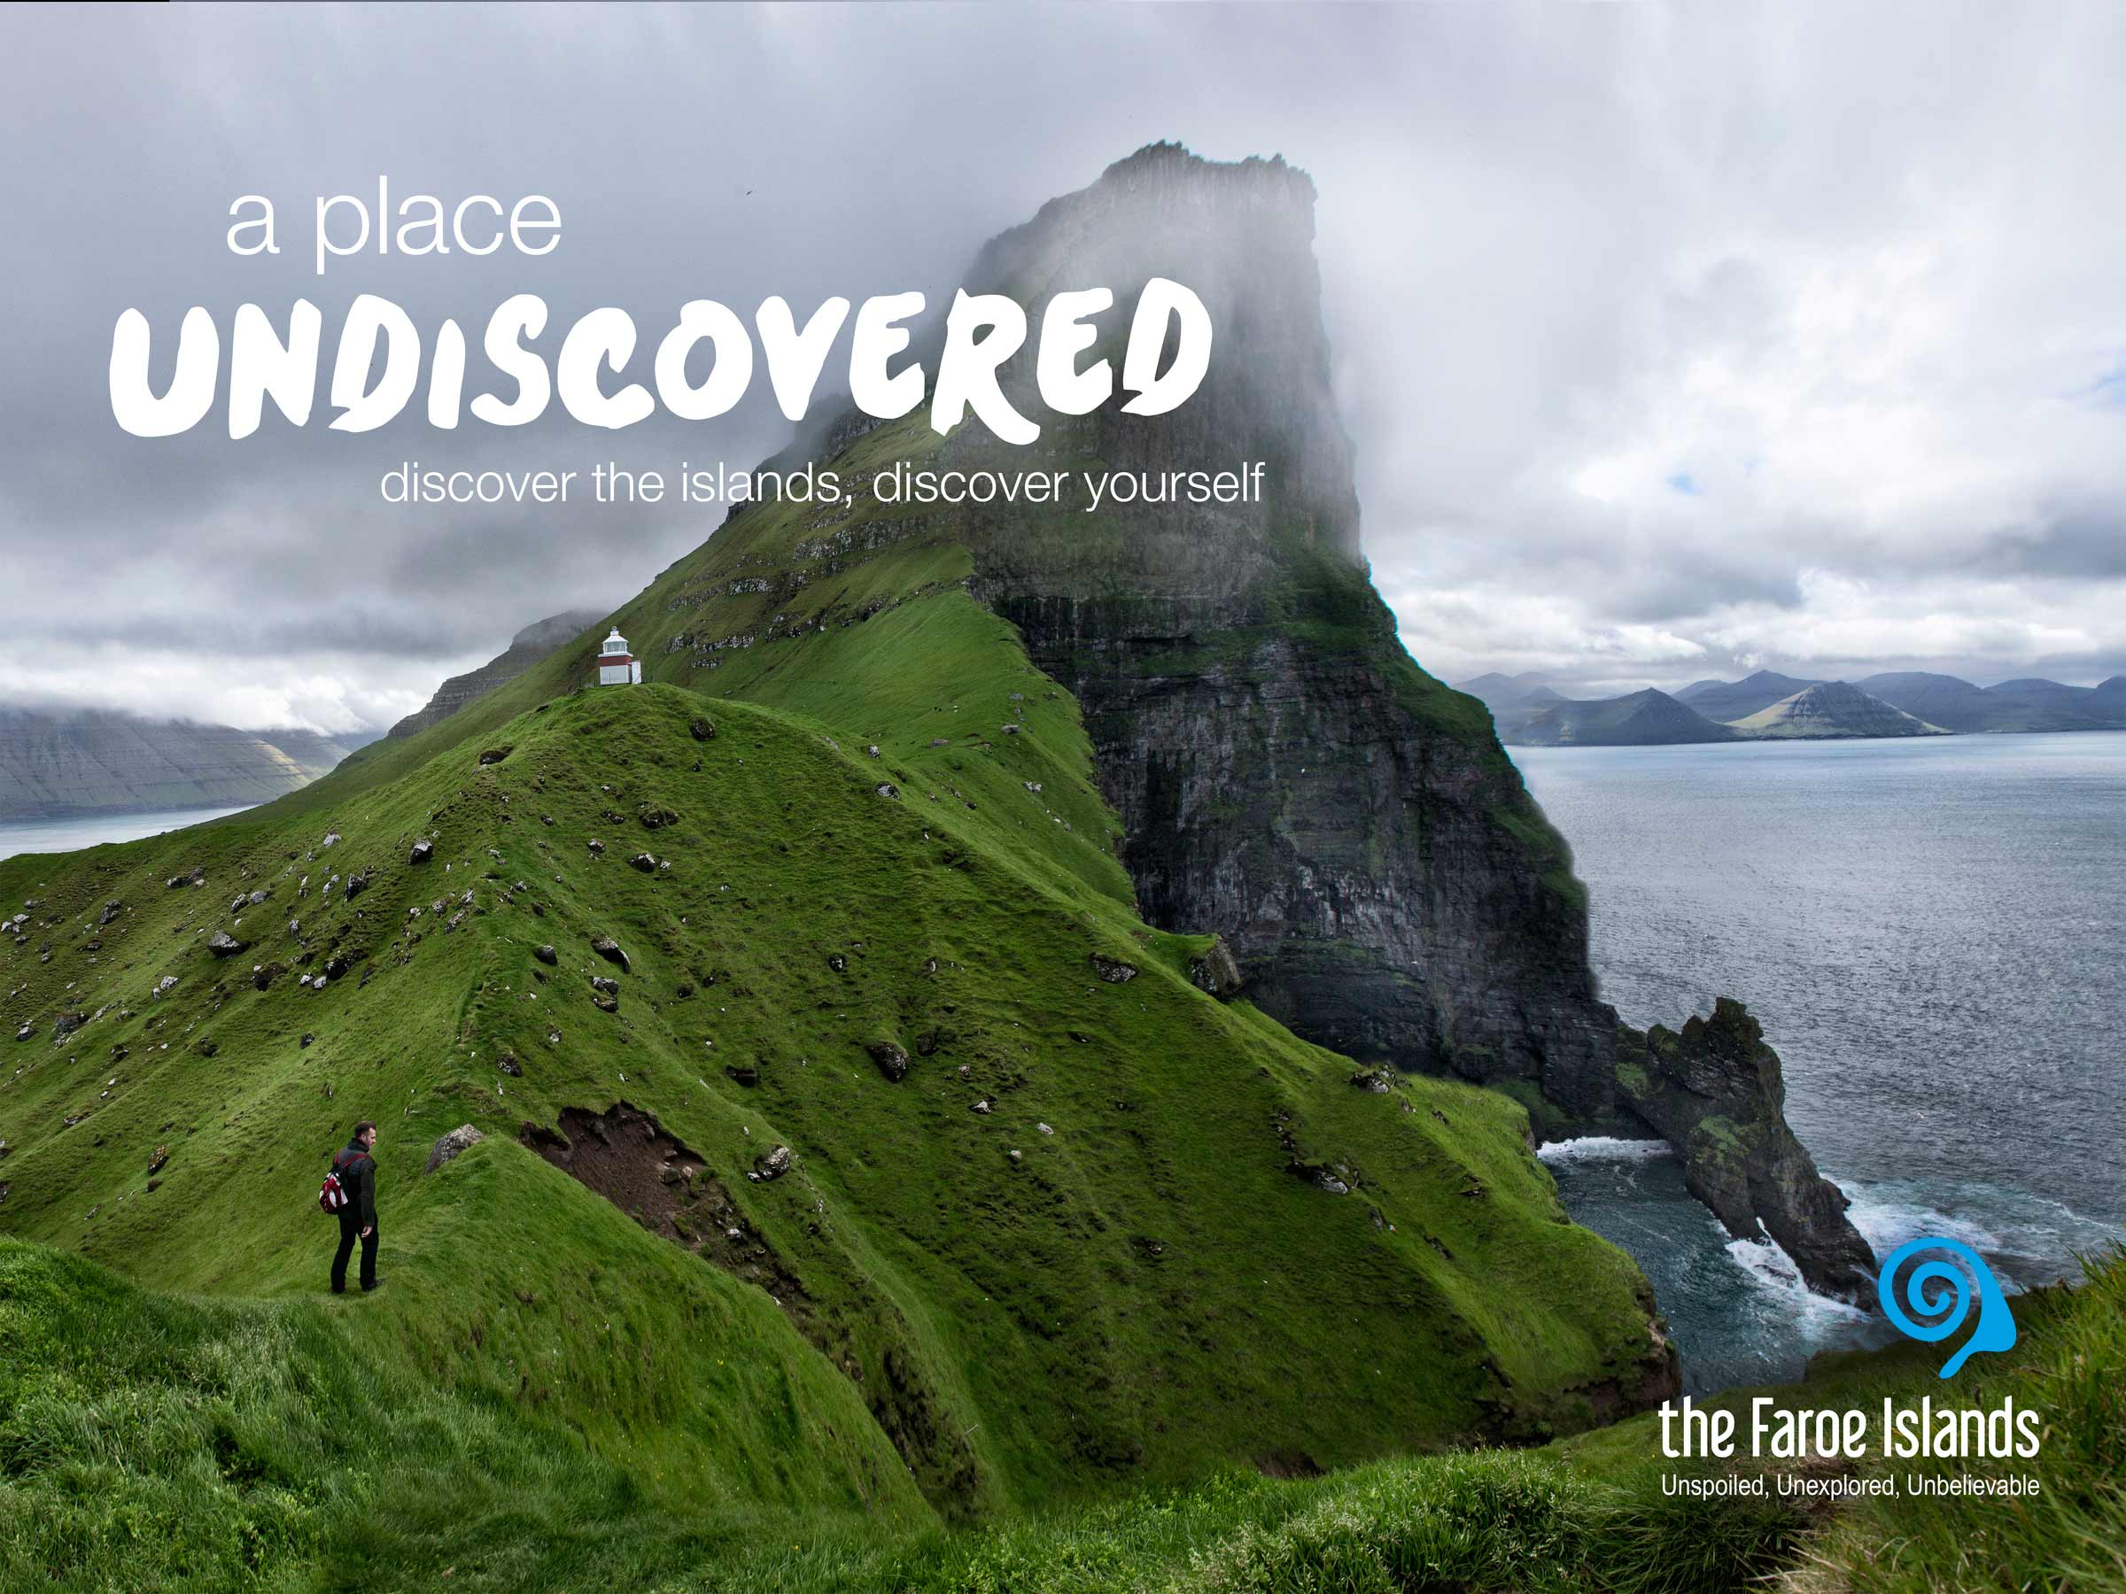
Notes:
Gævi gætur at Visit Faroe Islands eigur rættindi til allar myndirnar í framløgunum og at myndirnar bert kunnu brúkast í hesum líki í samband við framløgur um Føroyar.

Slide 4
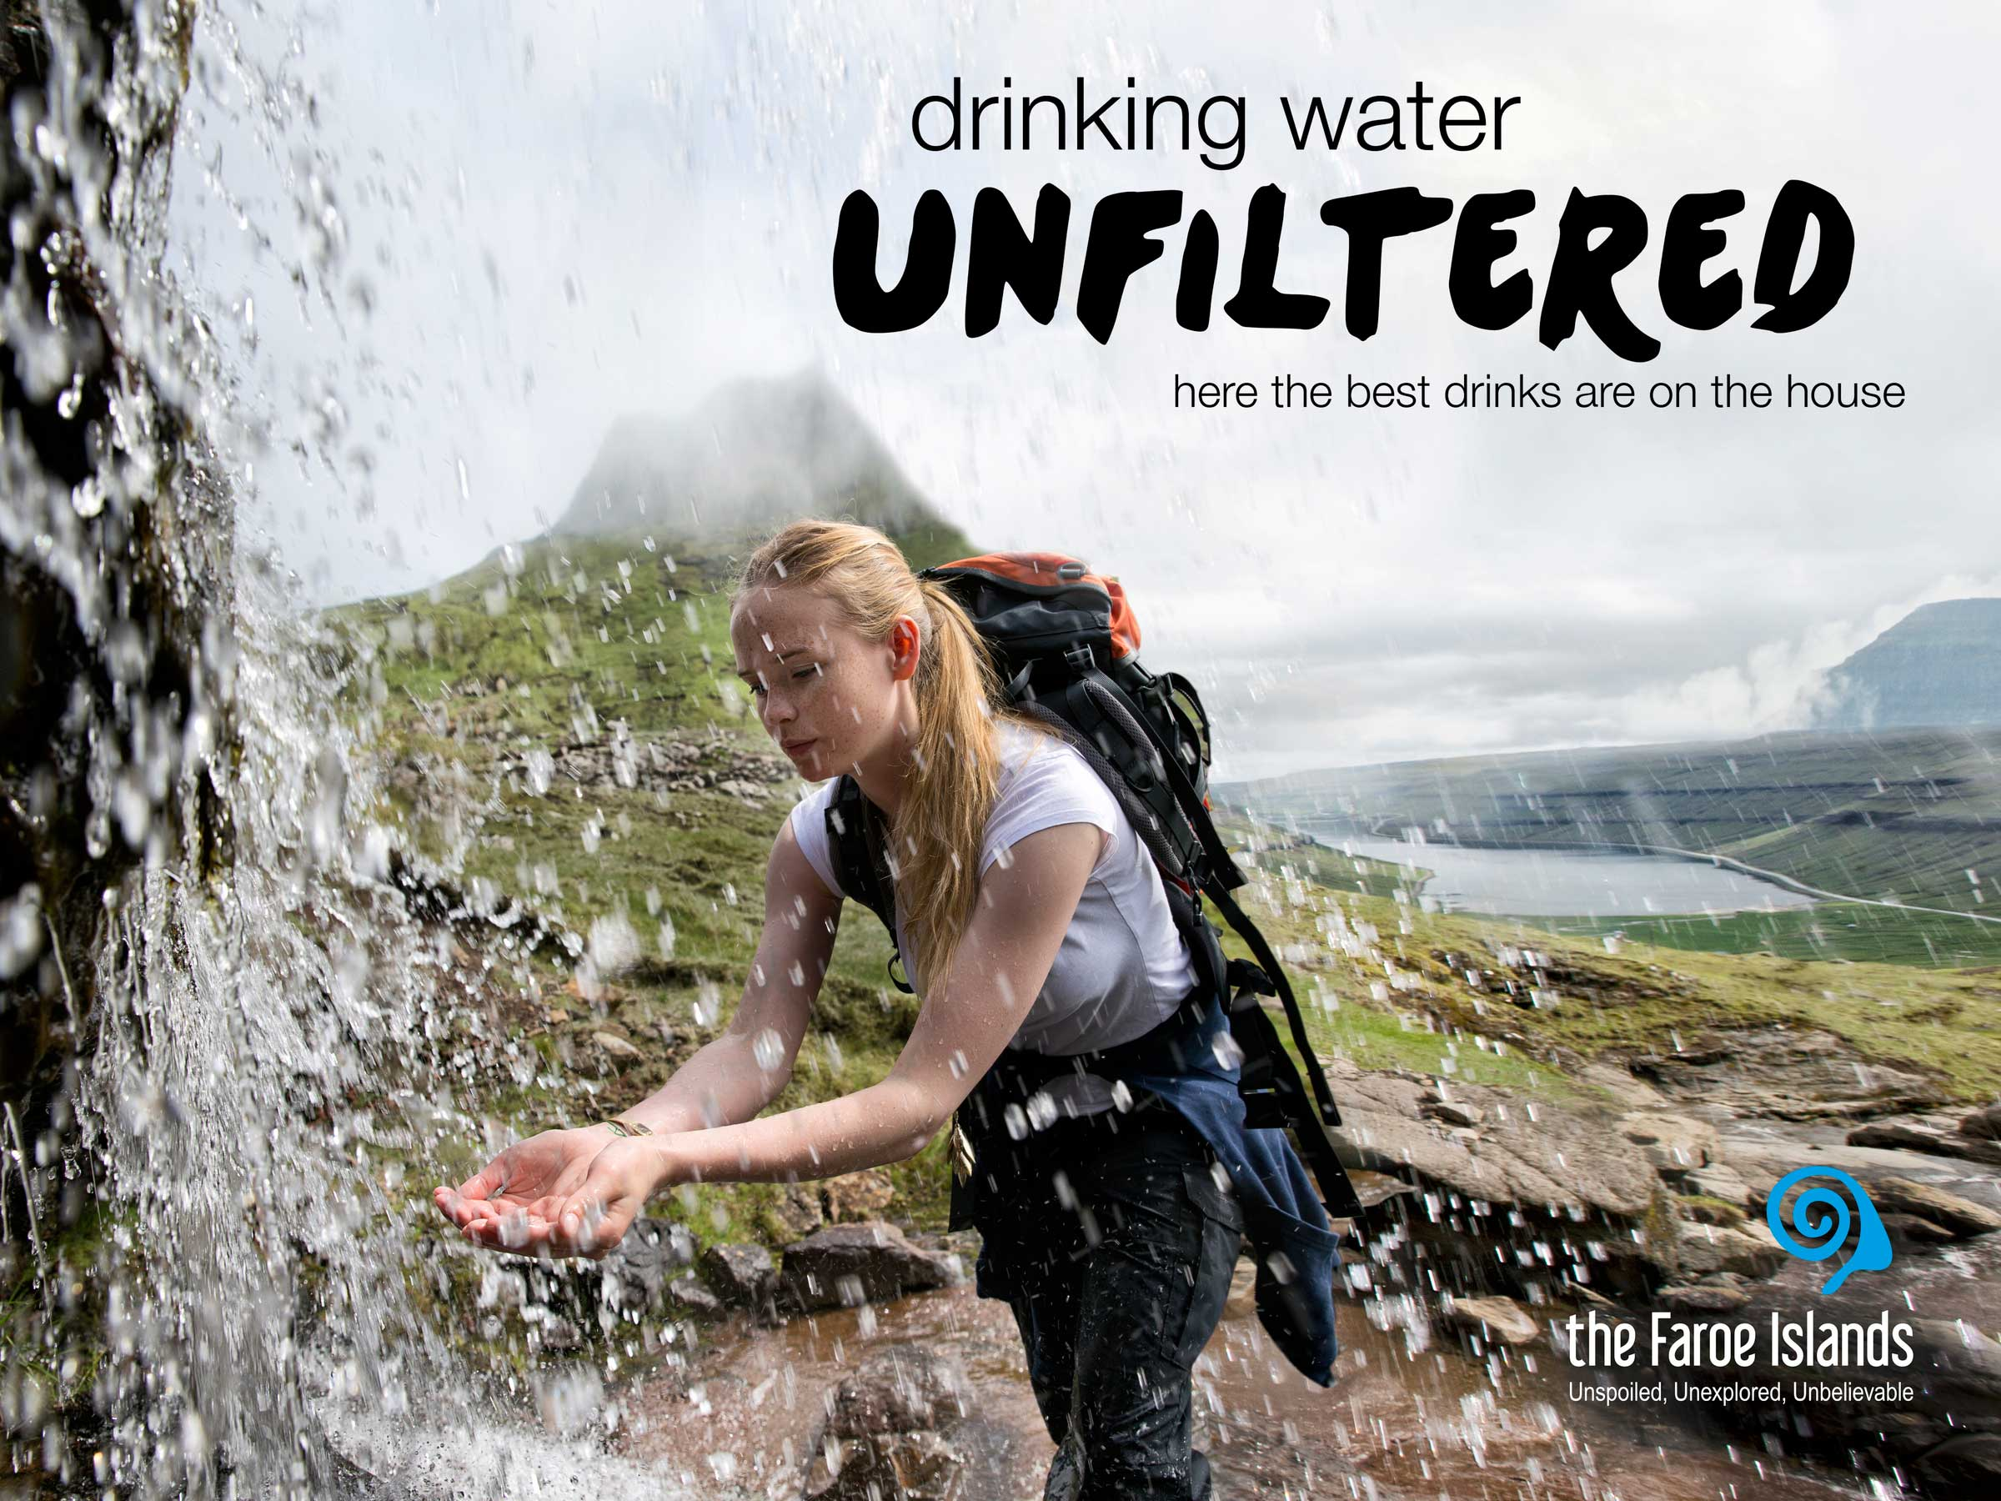
Notes:
Gævi gætur at Visit Faroe Islands eigur rættindi til allar myndirnar í framløgunum og at myndirnar bert kunnu brúkast í hesum líki í samband við framløgur um Føroyar.

Slide 5
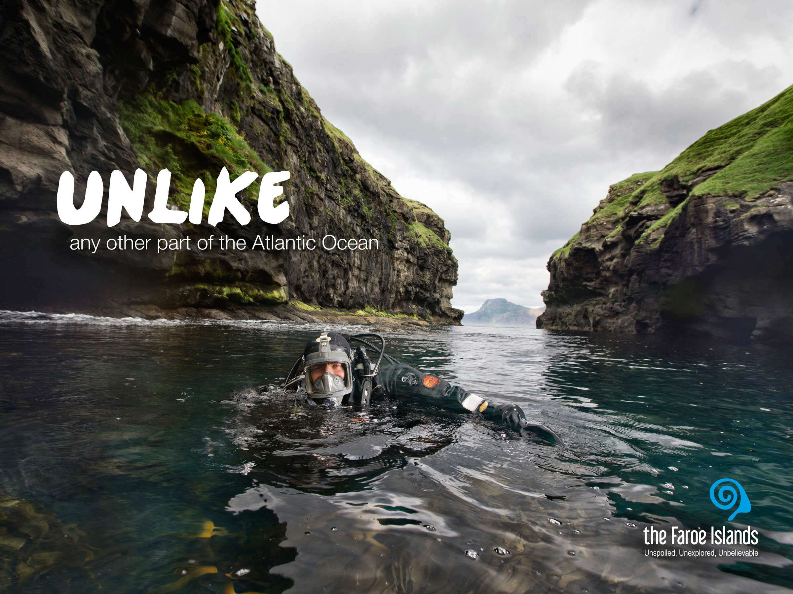
Notes:
Gævi gætur at Visit Faroe Islands eigur rættindi til allar myndirnar í framløgunum og at myndirnar bert kunnu brúkast í hesum líki í samband við framløgur um Føroyar.

Slide 6
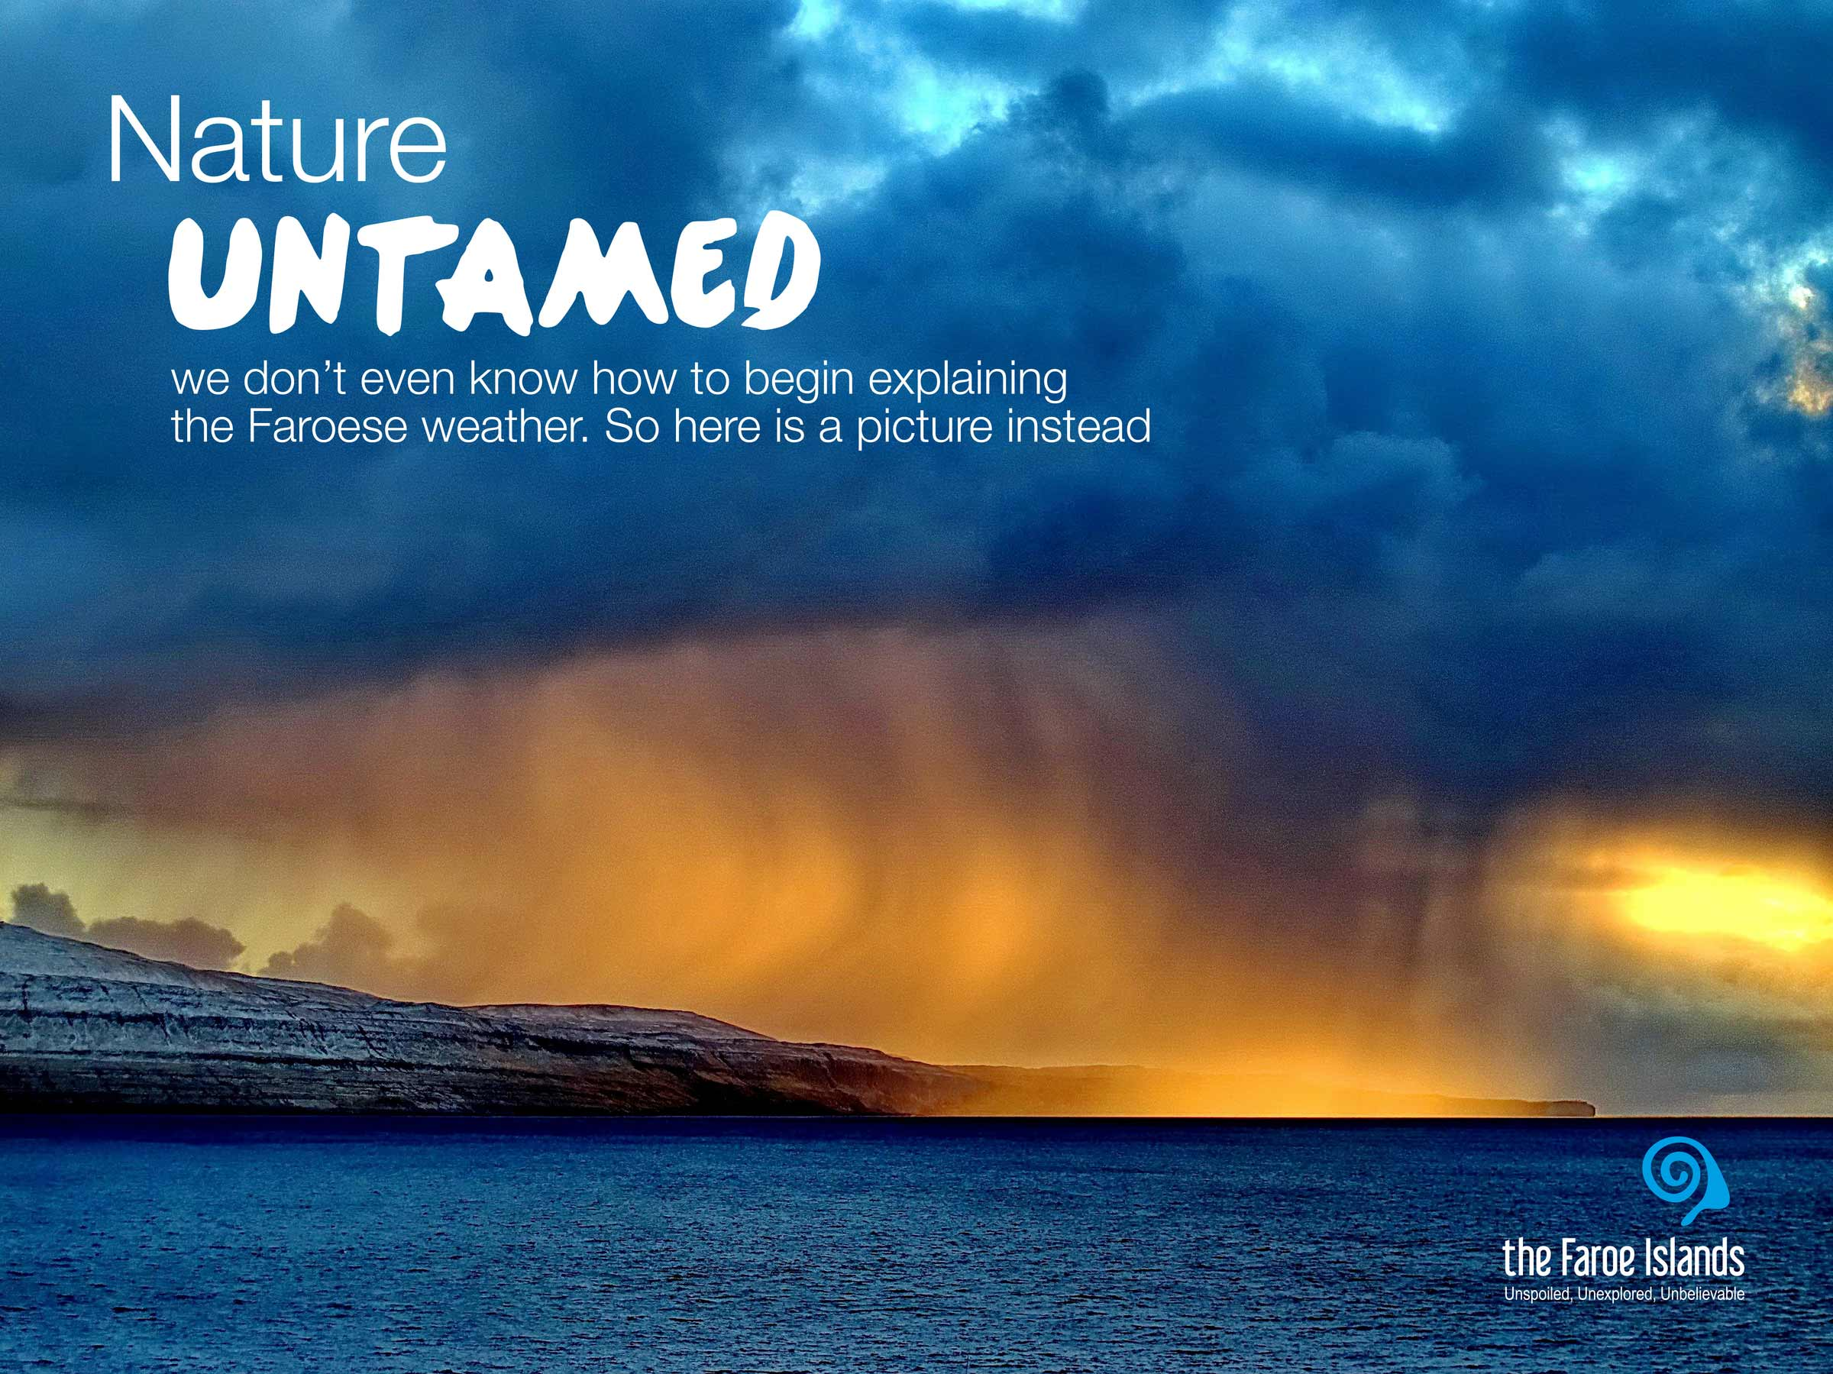
Notes:
Gævi gætur at Visit Faroe Islands eigur rættindi til allar myndirnar í framløgunum og at myndirnar bert kunnu brúkast í hesum líki í samband við framløgur um Føroyar.

Slide 7
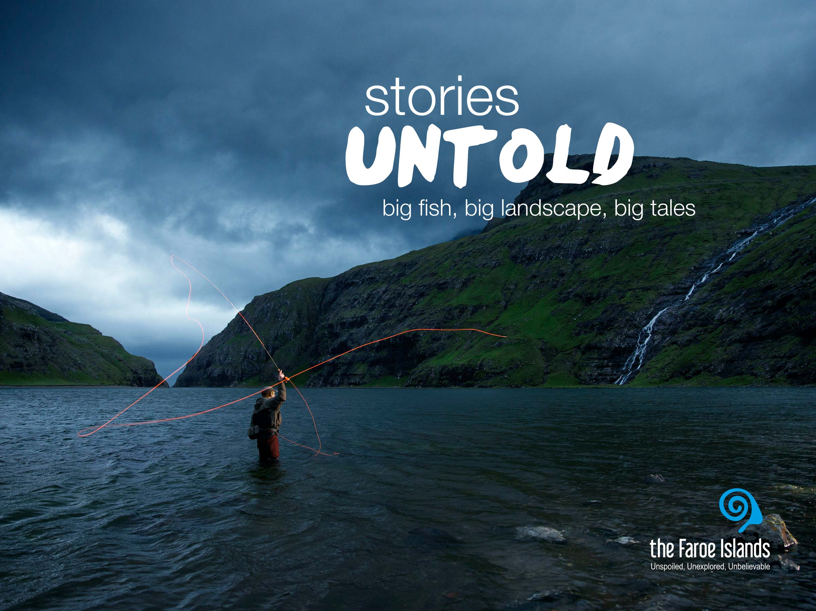
Notes:
Gævi gætur at Visit Faroe Islands eigur rættindi til allar myndirnar í framløgunum og at myndirnar bert kunnu brúkast í hesum líki í samband við framløgur um Føroyar.

